Slide 1

License plate reading
CS 270 Digital Image Processing
Shanghai Advanced Research Institute
CS 270 Digital Image Processing
Tang Zengming No. 2019E8018461004
Wang Heng No. 2019E8018461005
Notes:
亮亮图文旗舰店
https://liangliangtuwen.tmall.com

Slide 2
License Plate Detection
1

Slide 3
1
License Plate Detection
Flow Chart
Flow Chart

Slide 4
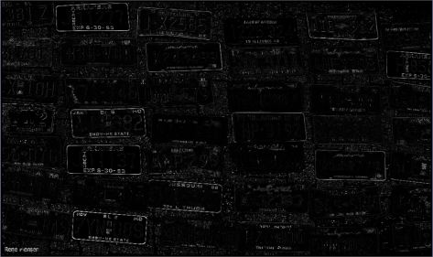
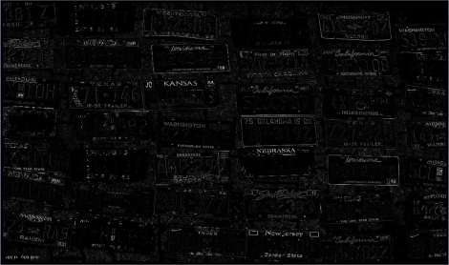
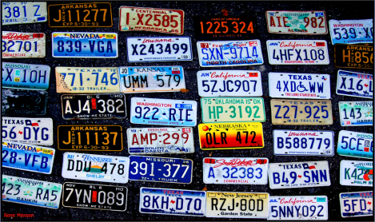
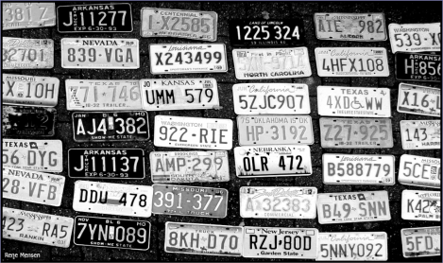
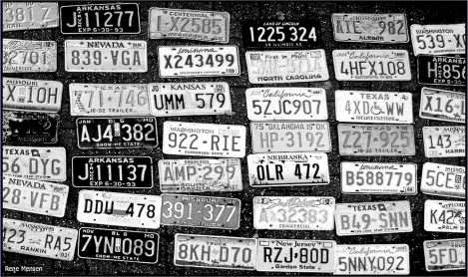
1
License Plate Detection
Single Channel Extraction/Contrast Enhancement
Single Channel Extraction
Contrast Enhancement
Value channel in HSV color model is extracted to form a single channel image
Contrast Enhancement by Top-hat transform

Slide 5
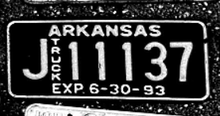
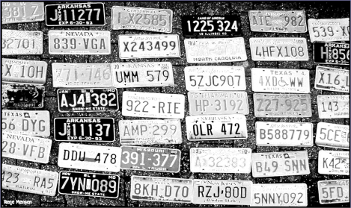
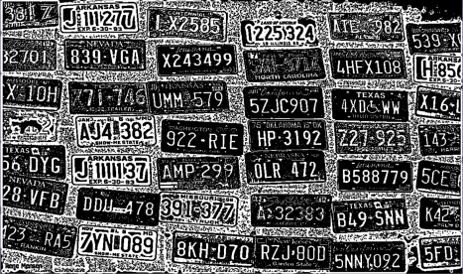
1
License Plate Detection
Small Edge Connection Connection/Thresholding
Small Edge Connection
Thresholding
Edges of some license plates boundaries are not connected, so dilation operation is used for expanding the edges.
Adaptive thresholding is adapted to convert the single channel image to a binary image.

Slide 6
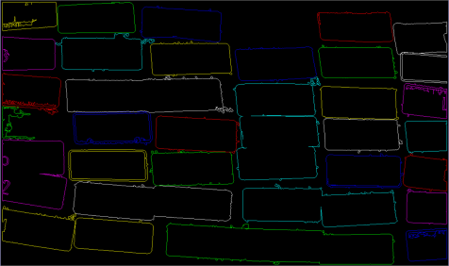
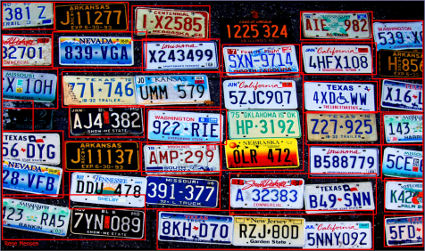
1
License Plate Detection
Bounding Box Cutting
Bounding Box Cutting
First, we detect contours by cv2.findContours. Detecting a license plate can be formulated as finding an inner edge while joint of plates and background can be the outer edge. So, we organize all of the contours into a two-level hierarchy and filter the contours whose area are smaller than a set threshold(2000 is proved the best threshold).
The largest and smallest value for x-dim and y-dim are counted for each inner contour.
To solve the problem that two or more license plates are enclosed by a bigger rectangle, width and height of well divided license plates are counted to crop the bigger enclosing rectangle horizontal or vertical on average.

Slide 7
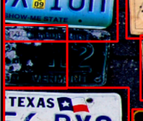
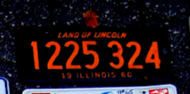
1
License Plate Detection
Bounding Box Cutting
Bounding Box Cutting
Finally, we detect 40 license plates in the original image while the total number of valid license plates is 41.
And the missed one has the same background with the background in the whole image.
The result is excellent.
A wrong detection is conducted in the blurred plate. But it can be filtered by the statistical width.

Slide 8
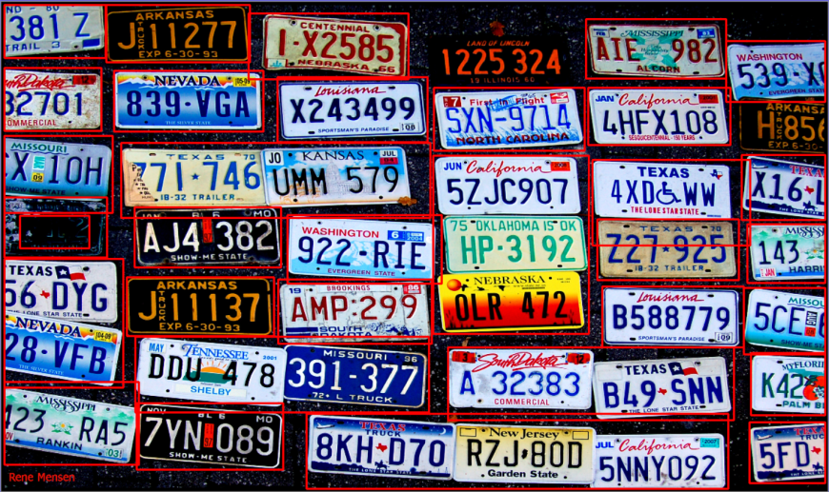
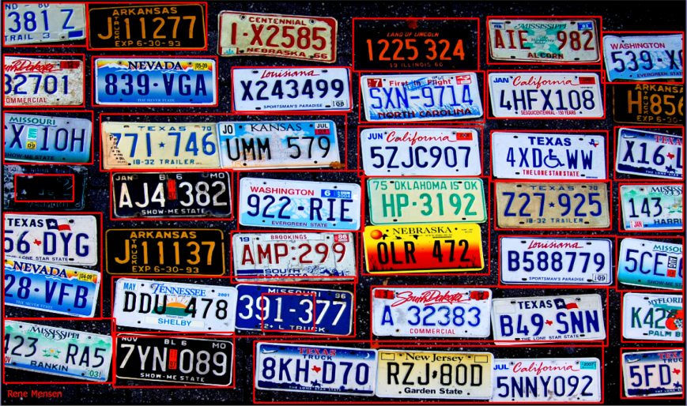
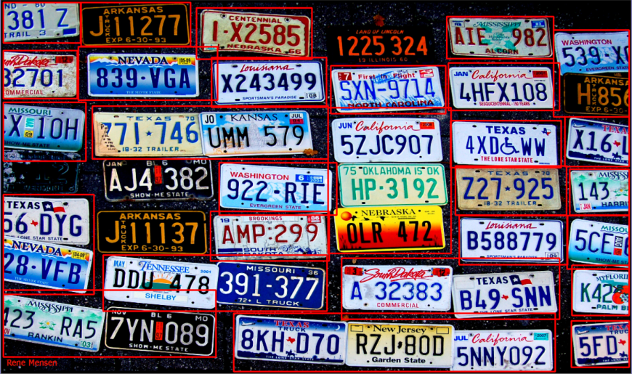

1
License Plate Detection
Discussion
Discussion
w/o
contrast enhancement(39/41)
w/o
small edge connection(39/41)
Our Method(40/41)
Threshold(4000)
in bounding box cutting(38/41)
Threshold(5000)
in bounding box cutting(38/41)

Slide 9
Character Segmentation and Recognition
2

Slide 10
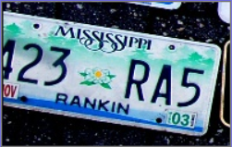
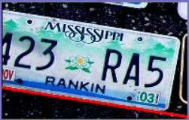
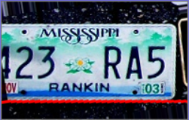
2
Character Segmentation and Recognition
License plate pretreatment
Skew Correction is important because tilted license plates and characters are hard to process.
Hough transform is concerned with the identification of lines in the image. We apply it to identify the top edge of license plate. Besides, the angle of this line can help to correct skew.

Slide 11
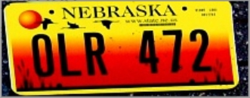

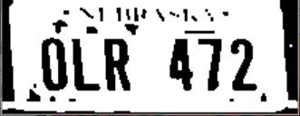
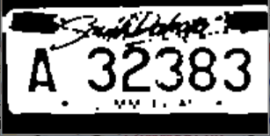
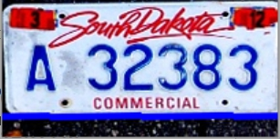

2
Character Segmentation and Recognition
License plate pretreatment
We convert the BGR image to a gray image, and then use the OTSU method to convert the gray image to a binary image to easily match the template of the binary image.
However, some backgrounds are gradient and dark images are difficult to separate well, we tried to enhance the contrast, which is helpful for this image, but it is disastrous for other images:
We don’t considered for enhanced contrast.

Slide 12
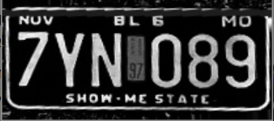
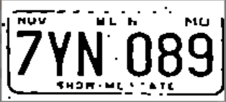
2
Character Segmentation and Recognition
License plate preprocessing
Then, the opening operation and the closing operation are performed.
Because some license plates in the image are black and different from other license plates, color inversion is required. When a black license plate is used, its white pixels are few, less than 30%. 255-pixel.

Slide 13
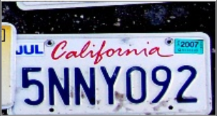


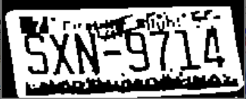
2
Character Segmentation and Recognition
Upper and down boundaries removal
Use row > x * max, max is the maximum row pixel value currently found, and x is set to 0.93, because sometimes the upper boundary is empty and it is pure white, so you must find a bottom and closest to the border of the character.
Some characters are too low:
So the range of the upper boundary is found to be 0.55 of the entire image, and the separation effect is not bad:：

Slide 14



2
Character Segmentation and Recognition
Upper and down boundaries removal
The lower boundary is a similar method. Sometimes the background color and noise will interfere with the judgment, and at the same time the font itself will interfere. Some letters have very wide lower borders, for example: "Z", "2", "D", "L", etc. Some letters have very narrow lower borders. , So set a parameter to balance these.

Slide 15
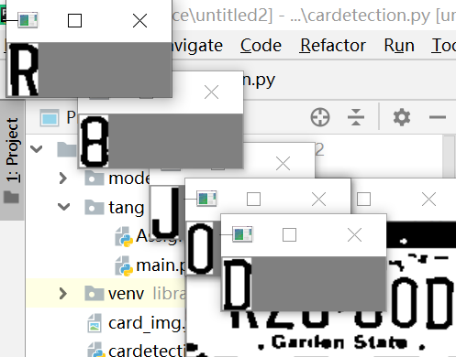
2
Character Segmentation and Recognition
Character Segmentation
The method of character segmentation is similar to the upper and lower borders.The problem is how to recognition noise and the background because col is narrow.
We make a his_max is row * 255, and x is 0.95, 0.95 You can find narrow character boundaries such as "T", while also limiting noise and background to a limited extent.

Slide 16
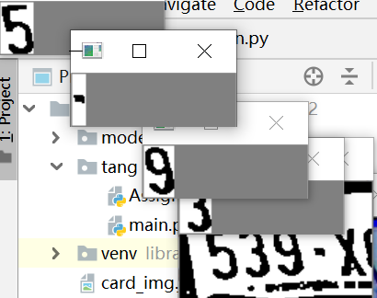
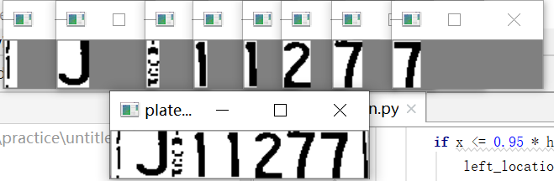
2
Character Segmentation and Recognition
Character Segmentation
In the image, the background pattern in the middle of the font is often cut into it. Initially, it was expected to limit the size of the background pattern. However, when the font size is limited, some characters such as "I", "1", etc. It is also very small and will be excluded. In order to avoid excluding license plates, we have retained the background pattern.
In the original image, some pictures are oblique. Although the license plate reaches the horizontal position, sometimes the fonts of some image fonts obtained are often slanted, which will affect the font segmentation.

Slide 17
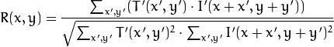
2
Character Segmentation and Recognition
Character Recognition
The template picture is compared with the segmented characters, and the matching formula using the normalized correlation matching method is as follows:
The recognition effect is as follows: there are some similar characters, such as "0" "O", "3" "8", "0" "D", "I" "1", "2" "Z", etc., they are not easy distinguish. Therefore, the effect is not good during recognition. The other edges of the characters are difficult to recognize. The background is dark and the gradient is not distinguished, so the effect is not good. The final recognition success rate is about 60.67%.

Slide 18
THANKS
感谢聆听
Notes:
亮亮图文旗舰店
https://liangliangtuwen.tmall.com

